Slide 1


Songs Analysis with Power BI
MENTORNESS PROJECT Data Analysis internship Virginia Mamdouh Tawfik

Slide 2
Problem Statement:
This project aims to conduct a comprehensive analysis of YouTube songs data using Power BI.
The goal is to utilize Power BI to create insightful visualizations and reports that provide a deeper understanding of YouTube songs' performance, popularity, and user engagement.
The analysis aims to uncover trends, preferences, and patterns in the data to aid content creators and stakeholders in optimizing their YouTube song content.

Slide 3
Dataset Description:
1. video_id: Unique identifier for each YouTube video.
2. channelTitle: Title of the YouTube channel publishing the song.
3. title: Title of the YouTube song video.
4. description: Description provided for the YouTube song video.
5. tags: Tags associated with the YouTube song video.
6. publishedAt: Date and time when the YouTube song video was published.
7. viewCount: Number of views received by the YouTube song video.
8. likeCount: Number of likes received by the YouTube song video.
9. favoriteCount: Number of times the YouTube song video has been marked as a favorite.
10. commentCount: Number of comments posted on the YouTube song video.
11. duration: Duration of the YouTube song video.
12. definition: Video definition or quality (e.g., HD, SD).
13. caption: Availability of captions for the YouTube song video.

Slide 4
Project Objectives:
Data Cleaning and Preparation:
Clean and preprocess the dataset, handling missing values or outliers.
Convert relevant columns to appropriate data types.
2. Exploratory Data Analysis (EDA):
Explore patterns and distributions in view counts, like counts, and comments.
Identify trends in the popularity and engagement of YouTube song videos.

Slide 5
Project Objectives:
3. Content and Channel Analysis:
Analyze the distribution of videos across different channels.
Identify popular tags and their correlation with view counts.
4. Temporal Trends:
Explore how YouTube song video metrics vary over time.
Identify peak publishing times and their impact on engagement.v
5. User Engagement Insights:
Investigate relationships between likes, comments, and views.
Identify factors influencing user engagement with YouTube song videos.

Slide 6
Let’s see the dashboard and discuss it

Slide 7
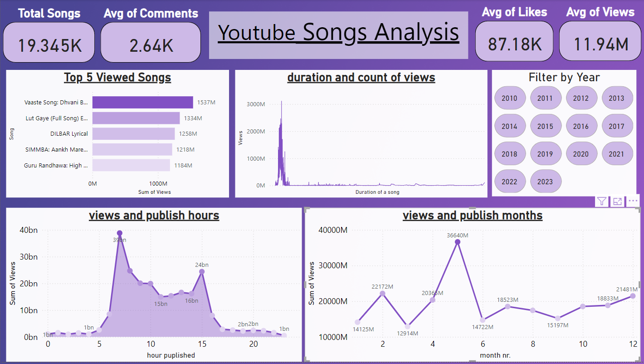

Slide 8
Insights and Recommendations:
Shorter videos have more views than long duration songs.
Videos published between 5 am and 15 pm are most viewed songs.
Also videos published between April and June have the most views.
Total songs among 14 years are 19345 song.
Average views are 11.94 million view and that’s a huge number, but on the other hand engagement with the songs are not that many.
Definition does not affect views or likes of a song that much.
Also most of the tags used are repetitive, that’s why I could not explore if it has a real affect on views and engagement of songs or not.

Slide 9
Thank You ☺

